Slide 1
FY113 亞灣5G AIoT創新科技應用計畫 壽山動物園_整合辨識模組WEB API溝通格式 20241008_vFinal
2024.10.08
余為哲

Slide 2
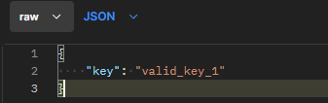
<SEND SECRET KEY> http://127.0.0.1:5000/detect_module_api/send_key
Method | Headers |  | Body |  |  | Error Response Msg
 | Key | Value | Name | Value | Type | Code | Content
POST | Content-Type | Application/json | key | Secret Key | Str | 403 | Invalid Key
 |  |  |  |  |  | 404 | Post Requests Unknown

Slide 3
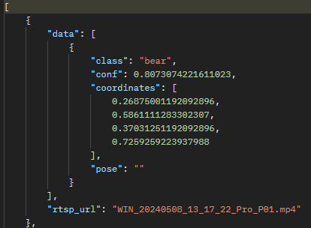
<GET OBJECT DETECTION RESULTS> http://127.0.0.1:5000/detect_module_api/object_detection
Method | Headers |  | Error Response Msg
 | Key | Value | Code | Content
GET | Content-Type | Application/json | 500 | Exception Msg
 |  |  | 501 | Failed to open RTSP stream
 |  |  | 502 | Failed to read frame from RTSP stream
 |  |  | 800 | GET Requests Unknown
Name | Type
class | str
conf | float
coordinates(normalized) | float
pose | str
rtsp_url | str

Slide 4
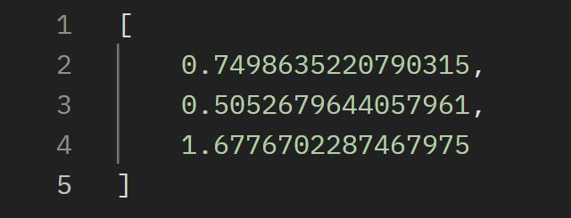
<GET LOCALIZATION RESULTS> http://127.0.0.1:5000/detect_module_api/localization
Method | Headers |  | Error Response Msg
 | Key | Value | Code | Content
GET | Content-Type | Application/json | 500 | Exception Msg
 |  |  | 800 | GET Requests Unknown
Index | Value
[0][1] | X,Y (Ratio)
[2] | Z (meter)

